Slide 1
Reducing Chinook Salmon Bycatch with a Market-Incentive Program: Legacy Allocation of Individual Tradable Encounter Credits (ITEC)
How Legacy Allocations and Trading of ITEC effectively address the C-2 Motion PPA requirements for an Inter-Cooperative Agreement
George Sugihara and Hao Ye

Slide 2
ICA requirements to participate in the 68,392 hard cap scenario
(as specified in the PPA)
An ICA must provide incentive(s) for each vessel to avoid salmon bycatch under any condition of pollock and salmon abundance in all years.
Incentive measures must include rewards for salmon bycatch avoidance and/or penalties for failure to avoid salmon bycatch at the vessel level.

Slide 3
ICA requirements to participate in the 68,392 hard cap scenario
(as specified in the PPA)
The ICA must specify how those incentives are expected to promote reductions in actual individual vessel bycatch rates relative to what would have occurred in absence of the incentive program. Incentive measures must promote salmon savings in any condition of pollock and salmon abundance, such that they are expected to influence operation decisions at bycatch levels below the hard cap.

Slide 4
Summary of the ICA requirements
Provide incentives at the individual vessel level.
Reward vessels that successfully avoid chinook and/or penalize vessels that fail to avoid chinook.
Incentivize vessels to avoid chinook bycatch at all levels of abundance in all years.
Incentives must influence fishing decisions at a level below the hard cap.
Notes:
reformatted

Slide 5
Components of the Recommended Market-Incentive Program
Legacy Allocation Component (long-term)
  reallocates ITEC based on consistent bycatch performance
  Insurance
Transfer Component (long & short-term)
  buy-side transfer limits
  Dynamic Salmon Savings (DSS)
  enhances allocation & trading incentives
Notes:
I reformatted and Added a few things…(long-short-term and trading incentives etc) … may want to save these additional incentive details for later slide?
… I tend to think yes, eliminate them from this slide (show only mechanics: realloc, buyside, dss)… but you can mention them in your narrative? Or later?

Slide 6
Legacy Allocation
Sectors are given fixed seasonal allocations of ITEC as specified in the PPA.
ITEC are distributed to individual vessels via the coops according to a uniform ITEC allocation formula. This formula adjusts allocations to reward low bycatch and penalize high bycatch.
The ITEC allocation formula is designed to distinguish consistent good/bad behavior from random noise. (i.e. chance encounters)

Slide 7
Legacy Allocation (cont’d)
Vessels that run out of ITEC must stop fishing. They can resume fishing only after buying sufficient ITEC to cover expected fishing activity.
  Efficient vessels with surplus ITEC can earn additional revenue by selling them.
  Vessels with high bycatch rates may need to purchase additional credits when they run out of ITEC.

Slide 8
 | Individual Incentives | Rewards/Penalties | Incentives at all levels of abundance | Operates at levels below the hard cap
Legacy Allocation | hyperlink
Buy Side Transfer Limit
Dynamic Salmon Savings
Notes:
Is this one still in progress?

Slide 9
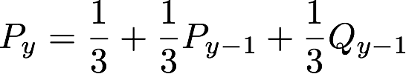
Uniform ITEC Allocation Formula
constant factor
(Pollock)
“legacy” component
(bycatch track record)
bycatch component
(penalty/reward)

Slide 10
Legacy Allocation Example
Consider three vessels, A, B, and C who begin the program with the same initial allocation of 100 credits.
During the first A season, vessel A has lower-than-average bycatch.
  Vessel B has an average amount of bycatch.
  Vessel C has higher-than-average bycatch.
Using modified z-scores, vessel A has a z-score of +1, vessel B has a z-score of 0, and vessel C has a z-score of -1.
Notes:
Somewhere … perhaps” on deck” you want to have those figures addressing normalization of z-scores from the appendix (Karl’s and our vessel size figure)… The vessel size one is especially relevant to the question of multiple vessels fishing for a single company. This issue will surely arise in discussion. As it involves DSS, transfers between vessels in a single company should be subject to PSSR. As DSS affects across sector transfers… participating sectors can be sellers (not buyers) of ITEC. Non-particiapting sectors (w/o DSS) can be buyers but not sellers of ITEC to participating sectors.

Slide 11
Legacy Allocation Example
Using the linear penalty function,
pi = zi / 4 + 1/2, pA = 3/4, pB = 1/2, pC = 1/4.
Using the bycatch function, Qi = 4/3 pi + 1/3, QA = 4/3, QB = 1, QC = 2/3.
Using the allocation formula,
Py = 1/3 + 1/3 Py-1 + 1/3 Qy-1
  For next year’s A season:
  Vessel A’s allocation increases by 1/9. (11%)
  Vessel B’s allocation does not change.
  Vessel C’s allocation decreases by 1/9.

Slide 12
Rewards and Penalties associated with Legacy Allocation
ITEC allocations are adjusted based on individual vessel bycatch performance:
  vessels with low bycatch rates are rewarded with increased ITEC allocation.
  vessels with high bycatch rates are penalized with decreased allocation.

Slide 13
Incentives associated with
Legacy Allocation
The Legacy Allocation rewards (and punishes) consistent good/bad behavior.
  Vessels need to continue to have lower-than-average bycatch to maintain the same level of increased ITEC allocation.
Increased ITEC allocation acts as insurance against running out of credits in moderate- and high-encounter years.

Slide 14
Magnitude of Legacy Incentives
During years of moderate to high-encounter:
  Many vessels run out of credits, so vessels may not be able to augment initial allocations through purchases.
  Vessels with reduced ITEC allocation can harvest lesser Pollock, resulting in large revenue losses.
  Vessels with increased ITEC allocation can harvest more Pollock, resulting in smaller revenue losses.

Slide 15
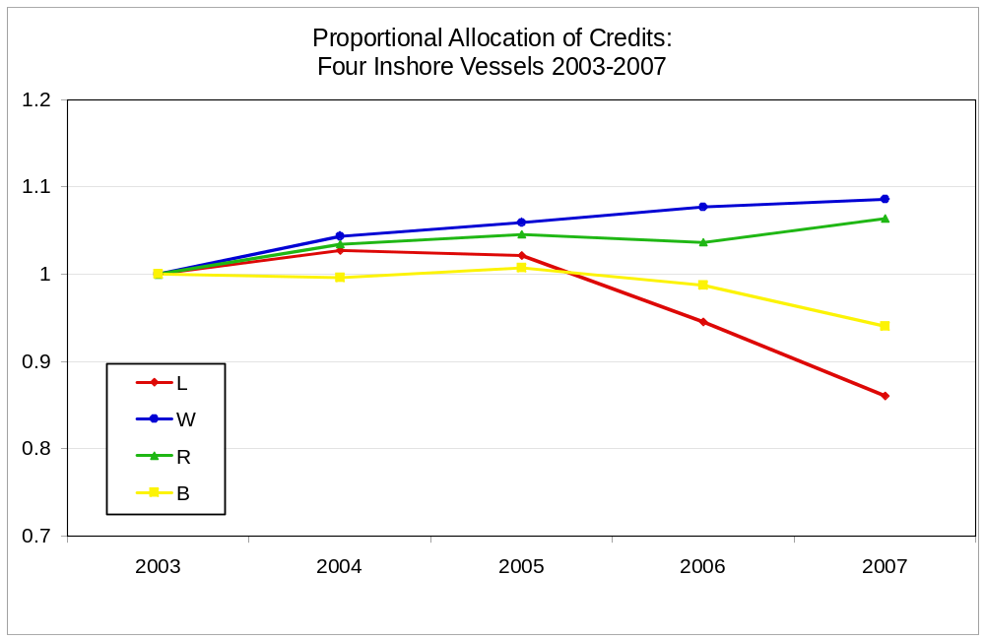
Magnitude of Legacy Incentives

Slide 16
Magnitude of Legacy Incentives
With extra legacy credits from fishing cleanly in 2003 and 2004, these vessels were able to capture significant additional revenue.
Vessel | 2005 credits gained/lost | Net Gain/Loss due to Legacy Reallocation
L | 0 | $0.00
W | 11 | $53,223.77
R | 24 | $116,146.40
B | 9 | $43,554.90

Slide 17
Magnitude of Long-Term Incentives
The costs of unfished Pollock under the PPA hard cap can be considerable for the Inshore sector.
Legacy Allocation redistributes ITEC to cleaner, more efficient vessels that can harvest more pollock for each ITEC.
Vessel | 2007 credits gained/lost | Net Gain/Loss due to Legacy Reallocation
L | (21) | ($58,184.09)
W | 17 | $47,101.41
R | 35 | $96,973.49
B | -29 | ($80,349.46)

Slide 18
Legacy Allocation during years of low salmon encounter
Reducing bycatch during low-encounter years has a larger effect on increasing ITEC allocation. Thus, incentives to reduce bycatch are stronger during these times.
Reducing bycatch by 10 salmon in 2003 (a low encounter years) increases ITEC allocation by an average of 2.44 credits in 2004.
Reducing bycatch by 10 salmon in 2006 (a high encounter years) increases ITEC allocation by an average of 1.11 credits in 2007.
Notes:
This slide follows “magnitude of incentives” discussion:
You mention # credits, but what is the VALUE in $? Is the number large enough? Or…. You can put this slide after the graphs?
Also, you can say the allocation incentive is 2X as high in low abundance years.

Slide 19
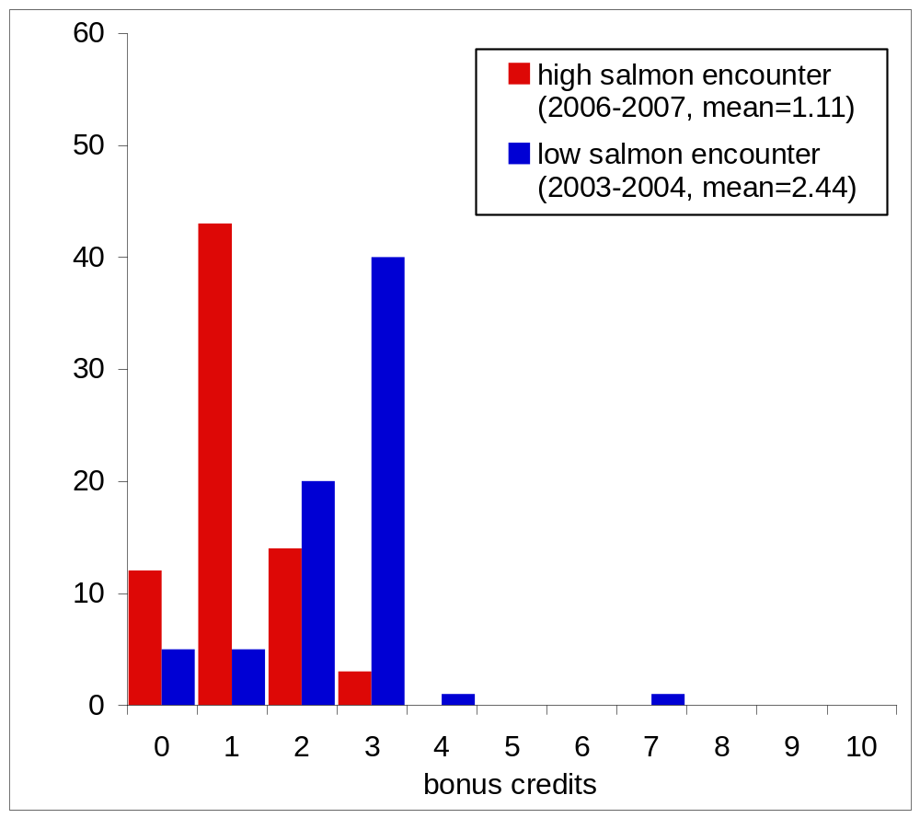
Legacy Program
Individual Vessel Incentives - Rewards: There is more reward incentive to avoid bycatch during low Chinook salmon encounter years. (blue)
Think of this as gaining additional insurance by fishing cleanly.
Notes:
edited

Slide 20
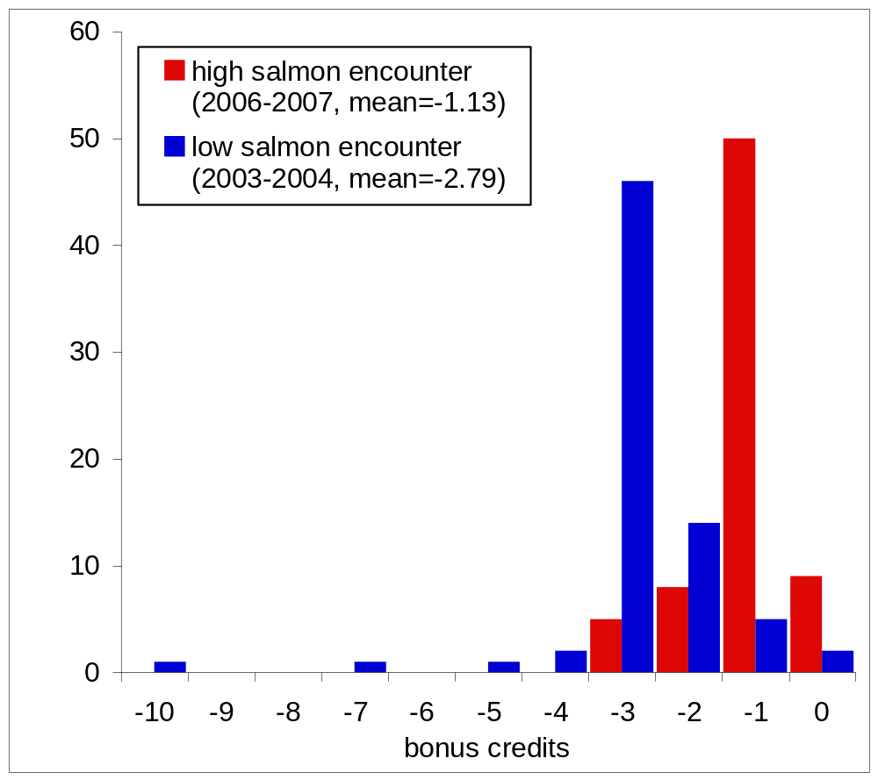
Legacy Program
Individual Vessel Incentives - Penalties: Every vessel’s future allocation of ITEC is at risk of being reduced if their relative performance is poor. This penalty is greater during low Chinook salmon encounter years. (blue)
Think of this as having reduced insurance due to high bycatch.
Notes:
Format adjusted

Slide 21
Why have transfer rules?
During years of low salmon encounter, the hard cap may be “too high”: an oversupply of ITEC for sale will lower credit prices and diminish the value of salmon.
Solution:
Create transfer rules to prevent this potential abuse and strengthen the incentives of Legacy Allocation.
Notes:
reformatted

Slide 22
Transfer Rules
Buy-Side Transfer Limit
  Vessels may only purchase a fixed fraction of their initial ITEC allocation.
Dynamic Salmon Savings
  A Salmon Savings Rate (SSR) determines the percentage of credits “retired” when a vessel finishes fishing.
  the SSR is adaptive to the level of salmon abundance.
Notes:
edited

Slide 23
Transfer Rules
Transfers occur between individual vessels.
Transfer Rules amplify vessel-level incentives by regulating transfers to:
  prevent abuse of abundant credits during low-encounter years
  increase short-term trading incentives (esp in low encounter years).
  increase strength of long-term incentives created by Legacy Allocation
Notes:
Edited… also, fixed typo…short-term to long term etc.

Slide 24
Trading is Necessary
Under the PPA hard cap
year | # of Inshore sector vessels that run out of credits
2003 | 11
2004 | 33
2005 | 37
2006 | 54
2007 | 56
Notes:
Maybe this slide should be repeated …. To make this point earlier (with legacy)? … or perhaps use the graph, with the same title. Or just repeat this slide 2X.

Slide 25
Buy-Side Transfer Limit
Suppose that the limit is set at 1/3: vessels may only purchase up to 1/3 their initial allocation.
A vessel that is allocated 300 credits (for A and B seasons combined) can only purchase a total of 100 credits for the year.
Lease Provision: If the vessel then leases an amount of pollock equal to its original allocation (doubling the amount of pollock), the number of credits it may buy is also doubled to 200 credits.
Notes:
edited

Slide 26
Rewards and Penalties associated with Buy-Side Transfer Limits
The number of credits a vessel may buy moves in tandem with its ITEC allocation:
  Vessels with low bycatch rates are rewarded with increased buy-side limits. (in addition to an increased ITEC allocation)
  Similarly, vessels with high bycatch rates are penalized with decreased limits.

Slide 27
Incentives associated with
Buy-Side Transfer Limits
Vessels are limited in the number of credits they can buy.
There is uncertainty in the number of credits needed to finish fishing Pollock.
The costs of unfished Pollock can be high
Thus, vessels are incentivized to minimize bycatch so as to not run out of available ITEC. (initial allocation + purchase limit)

Slide 28
Dynamic Salmon Savings
(DSS)
An adaptive Salmon Savings plan that evens out the supply of saleable credits.
Limits the supply of ITEC during low encounter years (when salmon stocks are most vulnerable).
Does not hamper vessel’s ability to use full ITEC allocation if needed.
Notes:
Edited )

Slide 29
Dynamic Salmon Savings (DSS)
When vessels finish fishing in the B season, some credits are “retired”.
The percentage of credits “retired” is the Salmon Savings Rate (SSR).
The SSR is computed such that the sector has enough credits to harvest the remaining pollock.
Prior to the determination of an SSR, credit transactions are governed by a Provisional Salmon Savings Rule (like tax withholding).
Notes:
Edited )

Slide 30
Provisional Salmon Savings Rule (PSSR)
Prior to finishing fishing, (and having credits retired) vessels may still transfer credits.
The appropriate number of credits are set aside to cover eventual retirement. (PSSR is similar to tax withholding)
This number (PSSR) is determined by the maximum SSR before the SSR has been calculated.
This rule prevents avoidance of Dynamic Salmon Savings by selling credits before they can be retired.
Notes:
Edited & corrected.

Slide 31
Provisional SSR Example
Suppose the maximum SSR is 40%.
PSSR = Max SSR = 40%.
Thus, if a vessel wishes to sell 60 credits before the SSR is set, it must set aside 40 ITEC in reserve.
If the SSR is set to 40%, all 40 reserve credits are retired.
If the SSR is less than 40%, some of the 40 reserve credits are returned.
Notes:
edited.

Slide 32
Calculating a Salmon Savings Rate
The Salmon Savings Rate (SSR) is computed using an estimate of the number of credits needed to fish the Pollock allocation.
This estimate can be made accurately when 2/3 of the B season Pollock allocation is caught.
The SSR corresponds to the number of credits that are not needed to finish fishing the Pollock allocation.
Notes:
edited

Slide 33
Calculating a Salmon Savings Rate
A maximum SSR provides an upper bound on the SSR. It should be set so that the resulting Provisional Salmon Savings Rule does not prohibit required credit transactions.
  A maximum SSR set too high can make credits too expensive for vessels that need to buy ITEC before the SSR can be computed.
Notes:
edited

Slide 34
Calculating a Salmon Savings Rate
 | A | B | C | D | E | F
2000 | 16-Sep | 37001 | 254 | 7540 | 29461 | 79.6%
2001 | 11-Sep | 31578 | 277 | 7770 | 23808 | 75.4%
2002 | 5-Sep | 24955 | 1655 | 21550 | 3405 | 13.6%
2003 | 2-Sep | 24318 | 256 | 7560 | 16758 | 68.9%
2004 | 31-Aug | 25859 | 1890 | 23900 | 1959 | 7.6%
2005 | 29-Aug | 21122 | 4142 | 46420 | -25298 | 0.0%
2006 | 10-Sep | 12182 | 3591 | 40910 | -28728 | 0.0%
2007 | 2-Sep | 14848 | 1465 | 19650 | -4802 | 0.0%
A = date when 2/3 Pollock caught
B = sector credits remaining (including 100% carry-forward from A season)
C = bycatch caught (up to the date in A)
D = predicted season bycatch + buffer
E = estimated surplus credits
F = allowable salmon savings rate

Slide 35
Rewards and Penalties associated with Dynamic Salmon Savings
The value of ITEC is increased by Dynamic Salmon Savings.
  Efficient vessels with low bycatch rates are rewarded with additional revenue from selling more expensive credits.
  Inefficient vessels with high bycatch rates are penalized with higher credit prices.

Slide 36
Incentives associated with
Dynamic Salmon Savings
The supply of credits affects incentives to avoid bycatch: an overabundance of credits can reduce the strength of these incentives during years of low encounter.
Dynamic Salmon Savings regulates the supply of credits so that the incentives to avoid bycatch are maintained at all levels of abundance.
Notes:
edited

Slide 37
Dynamic Salmon Savings during years of low salmon encounter
The effective supply of credits is reduced most strongly during years of low salmon encounter.
  The value of ITEC is increased, increasing the strength of short-term trading incentives.
During these times, large numbers of credits may be retired (equivalent to a lowered hard cap), without affecting the ability of the Pollock Industry to finish fishing Pollock.
DSS does not affect a vessel’s ability to use ALL of its credits if needed.
Notes:
Edited …. But…
It Seems like somewhere earlier we should have a simple slide saying: 1) dss lowers effective credit supply in low “encounter” years. 2) dss does not affect a vessel’s ability to use it’s full allocation (all credits) of ITEC if needed (high encounter years). (I stuck one in … slide 28)
Also as DSS affects across sector transfers… participating sectors can be sellers (not buyers) of ITEC. Non-participating sectors (w/o DSS) can be buyers but not sellers of ITEC to participating sectors. This will tend to keep ITEC transfers within participating sectors. This will tend to keep ITEC transfers within participating sectors.

Slide 38
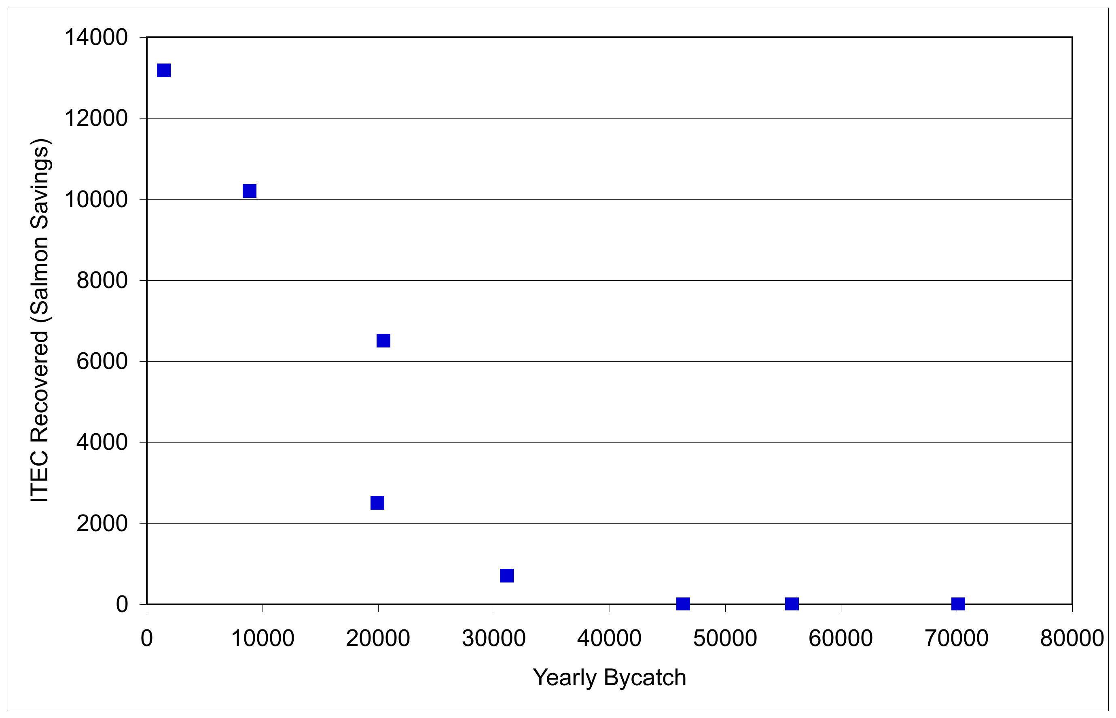
Dynamic Salmon Savings
Notes:
You should keep the comparison with a fixed tax in there. This is key, as the council was advocating it. I would not spend any time on it… just mention it.

Slide 39
Notes:
You need 1-2 summary slides that shows how the components work together (maybe the table?)
You need

